Slide 1
Cancer Services of New Mexico
Spring Cancer Family Retreat
Caring for the Caregiver
The Role of the Caregiver in the Journey of Cancer
Albuquerque, New Mexico
April 19, 2015

Slide 2

Caring for the Caregiver
Bio, Background, Qualifications …
Target Audience
Sunday Morning
Data & Statistics (not)
Movies & Metaphors

Slide 3
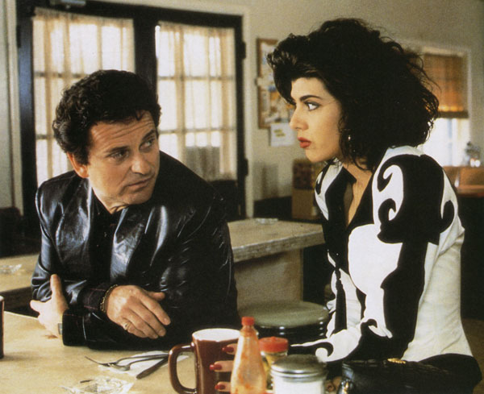

Slide 4
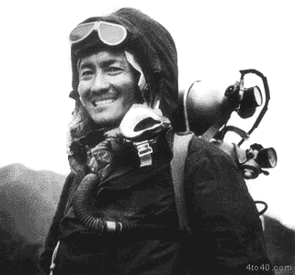
Tenzing Norgay
Sherpa

Slide 5
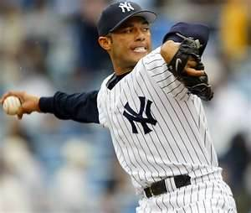
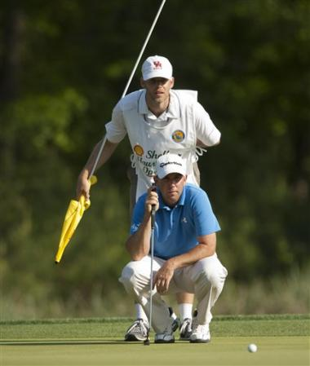
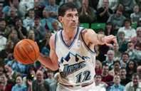
Supporting Roles
in Sports

Slide 6
Importance of Supporting Roles
    Behind the Scenes / Unsung Heroes
    “15 Minutes of Fame”
    Supporting Others is a Noble Purpose
“You can accomplish some amazing things in life, if you don’t care who gets the credit”
- Harry Truman

Slide 7

Roadmap (Agenda) for Today
Cancer & Caregiving
Roles & Responsibilities
Caring for the Caregiver
Human Connection
Adversity

Slide 8
Cancer & Caregiving

Slide 9

Cancer Care is Changing
  Terminal Disease ⇨ Chronic Disease
  “Manageable” “Treatable” “Curable”
  Cancer Survivorship is Growing
  Inpatient ⇨ Outpatient
  Today, spouses, families and friends provide about 80% of services that until recently, were done in clinical settings by trained healthcare professionals.
      National Cancer Institute

Slide 10

Cancer is a Journey
(Don’t Stop Believing)
  Diagnosis
  Treatment
    Surgery
    Chemotherapy
    Radiation
    Rehabilitation
  Post Treatment
  Survivorship

Slide 11
Who is a Caregiver?
  Most often, the primary Caregiver is a spouse, partner or an adult child
  When family is not available, friends, neighbors
  or co-workers may fill this role
  A Caregiver is the person who helps the person with cancer -- without being paid to do so
    Doctors and nurses are paid to be good
    Caregivers are good for nothing
☺

Slide 12
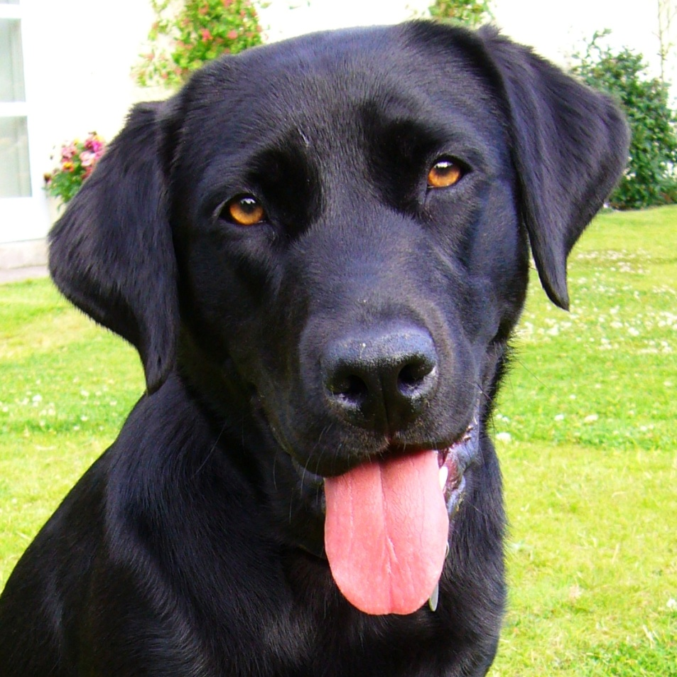
Who else is a Caregiver?
“Lord, help me become the person my dog thinks I am”
Bumper Sticker

Slide 13
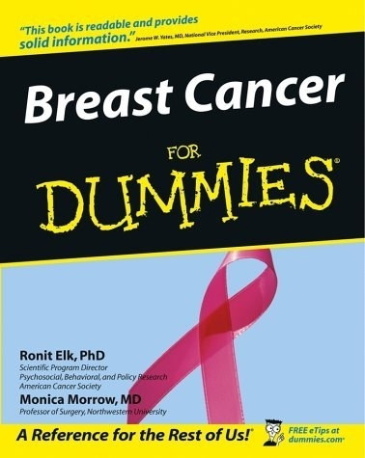
Becoming a Caregiver
Caregiving

Slide 14
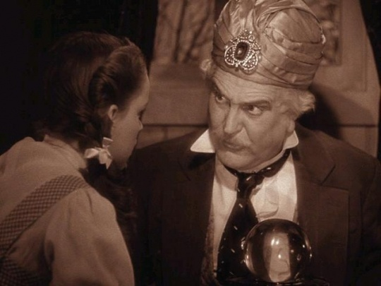
I’ve got some good news and I’ve got some …
There’s no…
    Crystal Ball
    Magic Wand
    Silver Bullet
    Text Book
    Check List
    Field Manual

Slide 15
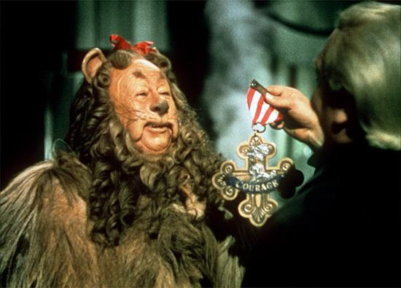
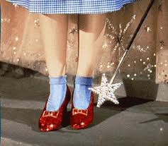
The Good News is …
You have what it takes to do the job
- You love the person you’re caring for
- The person you’re caring for loves you
- O.J.T.
(on the job training)

Slide 16
Roles & Responsibilities

Slide 17
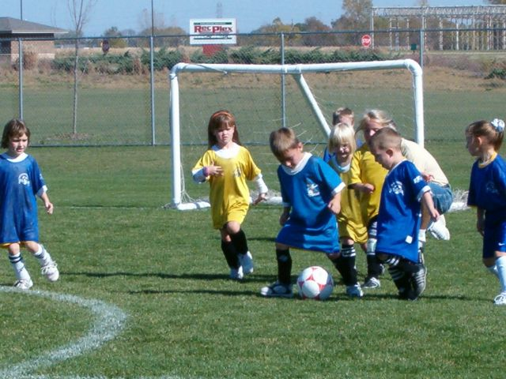
Know Your Role
People with Cancer
Doctors and Nurses
Caregivers
Family and Friends
Support Groups, etc.

Slide 18

Responsibilities of a Caregiver
  Advocate
  Dedicated
  Patience
  Good Listener
  Problem Solver
  Orchestrator
  Serving Heart
  Empathetic

Slide 19
Empathy (‘em-pə-thē)
  Definition:
  The action of understanding, being aware of, and sensitive to, the thoughts, feelings and experiences of another.
  Quote:
“Never criticize a person until you have walked a mile in their shoes,
that way when you do criticize them,
you are a mile away
… and you have their shoes ”
- Jack Handy (Deep Thoughts)

Slide 20
Caring for the Caregiver

Slide 21
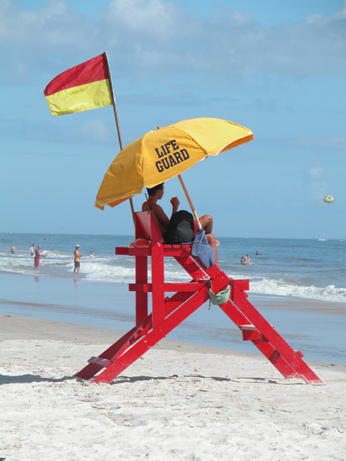
“A good lifeguard never gets wet”
- American Red Cross Lifeguard Training Manual

Slide 22
Caring for the Caregiver
  Top 10 things a Caregiver needs to do:
    Eat well, exercise and get rest
    Get (or stay) connected with others
    Keep your own doctors appointments
    Get and keep your “house” in order
    Learn about cancer and cancer treatment
    Learn to say “yes” to people who want to help
    Learn to say “no” when you need a break
    Recognize the “new normal”
    Be flexible (“go with the flow”)
    Be grateful for the blessings in your life

Slide 23
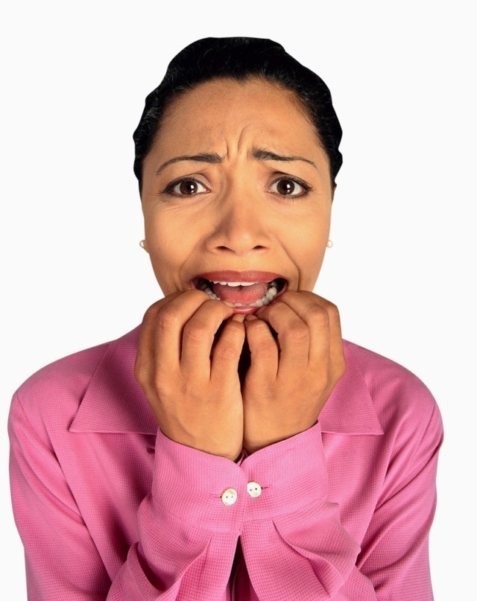
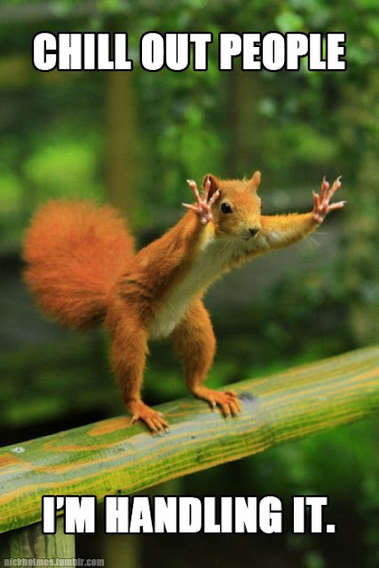
You are not alone
There is an abundance of resources out there
Let other people help when they want to

Slide 24
Human Connection

Slide 25
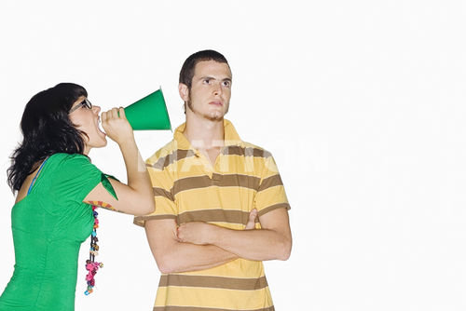
People Communicate in Different Ways
  Personality / Behavioral Profiles (Typically 4)
  Think of these as “Languages”
    Driver
    Social
    Steady
    Compliant

Slide 26
The Four Behavioral Profiles
Driver Social Steady Compliant
Direct Friendly Stable Analytic
Fast Paced Chatty Slower Paced Factual
Assertive Agreeable Predictable Rule Follower
Blunt Trusting Stoic Skeptical
Competitive Persuasive Reserved Perfectionist
Key Questions:
1. Which one are you?
2. What is everyone else?
3. What is the person you’re caring for?

Slide 27
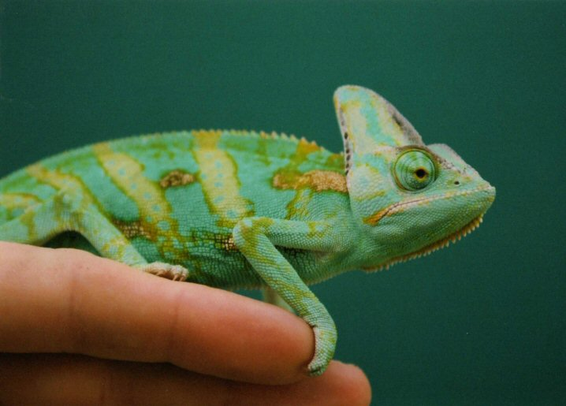
Speaking Other Behavioral Languages
The Short Cut …
Be a Chameleon

Slide 28


Human Connection
Venus & Mars

Slide 29
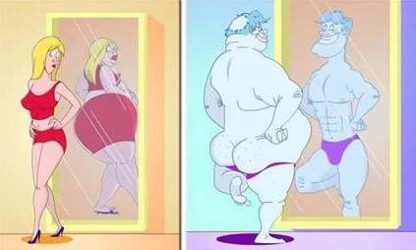
Venus & Mars
Perception

Slide 30

Venus & Mars
Application

Slide 31
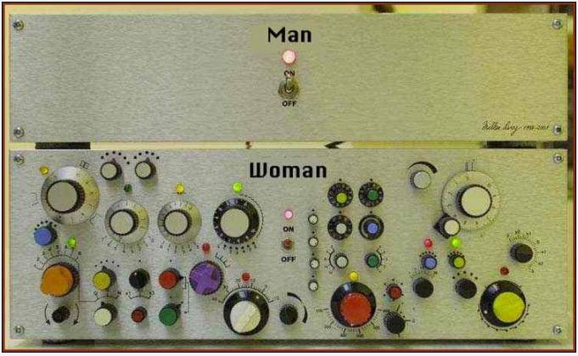

Slide 32
Adversity

Slide 33
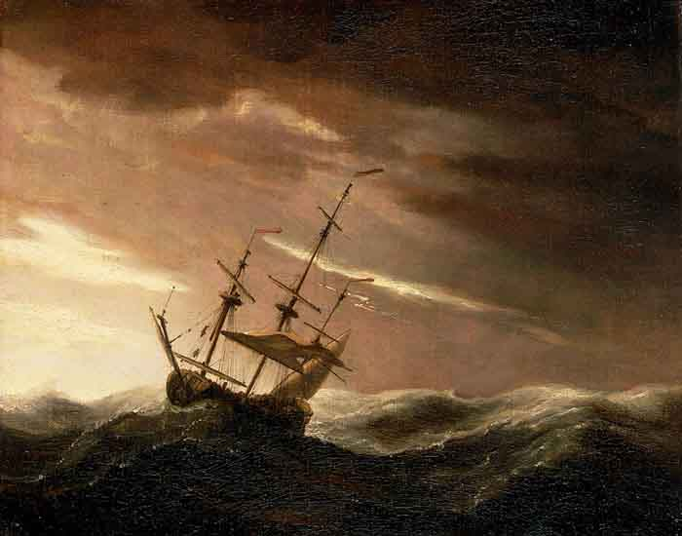
“Calm waters do not make a skilled sailor”
Ancient Chinese Proverb
    Adversity
    Challenge
    Suffering
      Leads to Strength
      Leads to Wisdom
      Leads to Enlightenment
      Ultimately Leads to Fulfillment

Slide 34
Key Messages
(Re-cap)

Slide 35
Caregiving & Cancer
Supporting Roles are underrated
You have what it takes to be a Caregiver
Know your Role and practice Empathy
You’re not Alone
Connect with the people you care for
Adversity is inevitable
- leads to good things

Slide 36
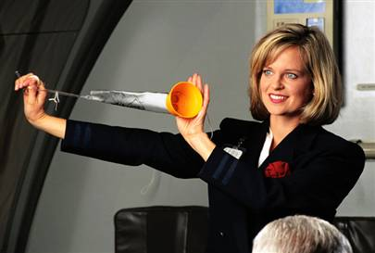
Caring for the Caregiver
Put your own mask on first …

